Slide 1
Library Law: Questions & Answers September 2020
Marti A. Minor, J.D., MLIS

Slide 2
Legal Disclaimer
These materials are provided as general information only.
No legal advice is being given by the Georgia Public Library Service, the Board of Regents of the University System of Georgia, or any other person.
You should consult with your attorney on all legal matters.

Slide 3
Families First Coronavirus Response Act
Emergency Paid Sick Leave Act
FFCRA §§ 3102(a)(2); 3102(b)
Emergency Family and Medical Leave Expansion Act FFCRA §§ 5102, 5110(2)
Effective Apr. 1, – Dec. 31, 2020

Slide 4
Application to Employee with Child Care Issues
An employee is entitled to emergency paid sick leave (up to 80 hours for full-time employee) if he/she is caring for a son or daughter whose school or place of care is closed or whose child care provider is unavailable for reasons related to COVID-19.
An eligible employee is entitled to up to 10 weeks of paid, and 2 weeks unpaid emergency family and medical leave if the employee is caring for a son or daughter whose school or place of care is closed or whose child care provider is unavailable for reasons related to COVID-19.

Slide 5
Info Required from Employee
An employee requesting leave to care for a son or daughter whose school or place of care is closed, or child care provider is unavailable, must also provide:
The name of son/daughter;
The name of the school, place of care, or child care provider that has closed or become unavailable; and
A statement that no other suitable person is available to care for the child.

Slide 6
Who is “son or daughter”
Under the FFCRA, a “son or daughter” is the employee’s own child, which includes a biological, adopted, or foster child, a stepchild, a legal ward, or a child for whom the employee is standing in loco parentis—someone with day-to-day responsibilities to care for or financially support a child.

Slide 7
Does Grandparent Stand In Loco Parentis?
Under the FMLA, persons who are in loco parentis include those with day-to-day responsibilities to care for or financially support a child.
Factors to be considered in determining in loco parentis status include:
• the age of the child;
• the degree child is dependent on the person;
• the amount of financial support, if any, provided; and
• how extensively duties assc’d w/ parenthood are exercised.
The fact that a child has a biological parent in the home, or has both a mother and a father, does not prevent an employee from standing in loco parentis to that child. The FMLA does not restrict the number of parents a child may have.
The specific facts of each situation will determine whether an employee stands in loco parentis to a child.

Slide 8
Documentation of In Loco Parentis Relationship
The employer’s right to documentation of family relationship is the same for an individual who asserts an in loco parentis relationship as it is for a biological, adoptive, foster or step-parent.
Such documentation may take the form of a simple statement asserting the relationship. For an individual who stands in loco parentis to a child, such statement may include, for example, the name of the child and a statement of the employee’s in loco parentis relationship to the child. An employee should provide sufficient information to make the employer aware of the in loco parentis relationship. See 29 CFR § 825.122

Slide 9
Rate of Pay
Rate of pay is 2/3 an employee’s regular to care for son or daughter whose school or place of care is closed due to COVID-19 related reasons.
For FMLA leave, the first two weeks are unpaid, but employee can elect to use sick leave under the Emergency Paid Sick Leave Act (at 2/3 regular rate) or any accrued leave (regular rate).
For the remaining ten weeks (weeks 3-12) of FMLA leave, the rate of pay = 2/3 regular rate.

Slide 10
Who are Eligible Employees?
Emergency Paid Sick Leave: all employees.
FMLA: employees who (1) have been employed for at least 30 days, and (2) have not already taken entire 12 weeks of FMLA leave.
**Remember this is a new reason for leave, not additional weeks.

Slide 11
What if Child is Voluntarily Kept Home from an Open School?
The DOL has not definitely addressed whether an employee can take FFCRA leave in situations where the employee has voluntarily chosen remote learning as opposed to his or her child physically returning to school.
Based on the language in the FFCRA, it seems that this employee would not be eligible for FFCRA leave because there was an option to return the child to school in person.
Therefore, the school is not considered “closed” due to a COVID-19–related reason.

Slide 12
More Info from US Dept. of Labor
Fact Sheet:
https://www.dol.gov/agencies/whd/pandemic/ffcra-employee-paid-leave
Questions & Answers:
https://www.dol.gov/agencies/whd/pandemic/ffcra-questions
Webinar Slides:
https://www.dol.gov/sites/dolgov/files/WHD/Pandemic/FFCRA_webinar.pdf

Slide 13
Collection Issues: Effect of Bankruptcy on Library Accounts?

Slide 14
Bankruptcy Basics
Article I, Section 8, of the US Constitution authorizes Congress to enact “uniform Laws on the subject of Bankruptcies.”
In 1978, Congress enacted the Bankruptcy Code, which is codified as title 11 of the United States Code.
This is the uniform federal law that governs all bankruptcy cases.

Slide 15
Chapter 7
Chapter 7, entitled Liquidation, contemplates a court-supervised procedure where a trustee takes over the assets of the debtor’s estate, reduces them to cash, and makes distributions to creditors, subject to the debtor’s right to retain certain exempt property and the rights of secured creditors.
The debtor receives a discharge that releases him or her from personal liability for certain dischargeable debts.

Slide 16
Chapter 13
Chapter 13, entitled Adjustment of Debts of an Individual With Regular Income, is designed for an individual debtor who has a regular source of income.
It allows the debtor to propose a “plan” to repay creditors over time– usually three to five years.
The plan must be approved by the Bankruptcy Court.
The debtor must complete the approved plan payments before receiving a discharge of debts.
The debtor is protected from lawsuits, garnishments, and other creditor actions while the plan is in effect.

Slide 17
Chapter 11
Chapter 11, entitled Reorganization is rarely used for individuals. If a debtor does qualify, it allows for negotiation with creditors to modify the terms of debts and create a repayment plan without having to sell assets.
The debtor receives a discharge that releases him or her from personal liability for certain dischargeable debts.

Slide 18
Can debts to the library be discharged?
Section 523(a)(7) of the Bankruptcy Code provides that fines payable to and for the benefit of a governmental unit which is not compensation for actual loss are not dischargeable. Think: overdue fines.
But, debts to a governmental unit that represent compensation for actual loss are dischargeable. Think: charges for lost or damaged materials.

Slide 19
How Does a Parent’s Bankruptcy Affect a Juvenile Acct?
In Ga., a person under 18 cannot contract for goods and services and any purported contract is unenforceable.
Therefore, it is advisable to have a parent sign on as the responsible party to a juvenile account.
Which means, debts incurred on the account ultimately belonging to the parent are subject to applicable bankruptcy laws applying to that parent.

Slide 20
One parent in BR, not the other.
A discharge of debt occurs only for the filing individual.
If only one spouse files BR, then only that person’s debt is affected.
A joint debt would still be owed by the non-filing spouse.

Slide 21
Borrowing privileges for non-BR family members?
Library administrators should carefully consider policies regarding borrowing privileges for families.
There is no legal issue with a policy that results in all family members being blocked if one of the cards is delinquent because borrowing library materials is a privilege, not a right.
Legal concerns arise if the library enforces collection efforts against the non-delinquent family member. Collection efforts must focus solely on the signatory of the account.
Competing policy considerations:
a family account policy that results in disabling all family members’ cards if one member is delinquent is troubling because an individual may be punished for the deeds of other members of the family over which he or she has no control.
But, the library has a responsibility to the public as a whole to protect its collections and this includes the duty to prohibit abuse of borrowing privileges.

Slide 22
Library as Host of Virtual Events

Slide 23
Copyright Concerns
Copyright protects original works of authorship, such as written materials and music. Publishers, authors, and artists hold the rights to their materials. It is generally considered fair use to share copyrighted stories and songs for library programs held in-house and for outreach programming, these implied permissions may change when library programs go online.
Obtain permission from publishers or artists first (unless using original work or materials from the public domain).
Attribute work to the publisher or artist appropriately.
Virtual Storytime Services Resource Guide: http://www.ala.org/alsc/virtual-storytime-services-resource-guide

Slide 24
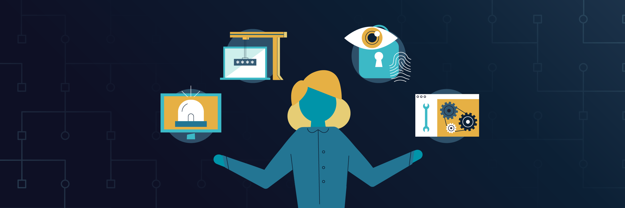
Security Precautions
Do you have insurance coverage to protect the library from liability for cyber-related issues?
When selecting platforms to use for hosting, consider subscription products rather than a consumer-grade download: such paid products often contain security features (and contractual remedies) not available via free apps.
ALA’s Office for Intellectual Freedom is available to assist with interpreting privacy and data retention policies and answering questions.

Slide 25
Participation by Minors
Find out whether the platform that you are using is compliant with the Children’s Online Privacy Protection Act (COPPA)—1998 law placing parents in control over what info is collected from their young children online. It applies to children under age 13.
Avoid platforms like social media that require your patrons to disclose personal information in order to engage with your virtual programs. Look for platforms that patrons can access anonymously.

Slide 26
Use of Personal Data
Alert participants to familiarize themselves with the platform’s use of data policies.

Slide 27
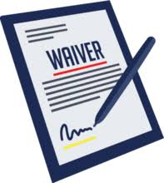
Waiver
Waivers are governed by the rules of contract law. In instances of gross negligence, such waivers are typically deemed unenforceable. However, in general, liability waivers can be enforceable so long as the party signing the waiver had fair notice, i.e. that the contract or waiver specifically stated the claims to be released and that the waiver language was conspicuous within the contract.
Sample: “Please be advised that the Library makes no warranties and/or representations concerning its virtual programs. Your decision to participate in the programs is an express consent on your part to waive any and all claims against the Library which may result from said participation and hereby release and discharge the Library from any and all liabilities.”

Slide 28
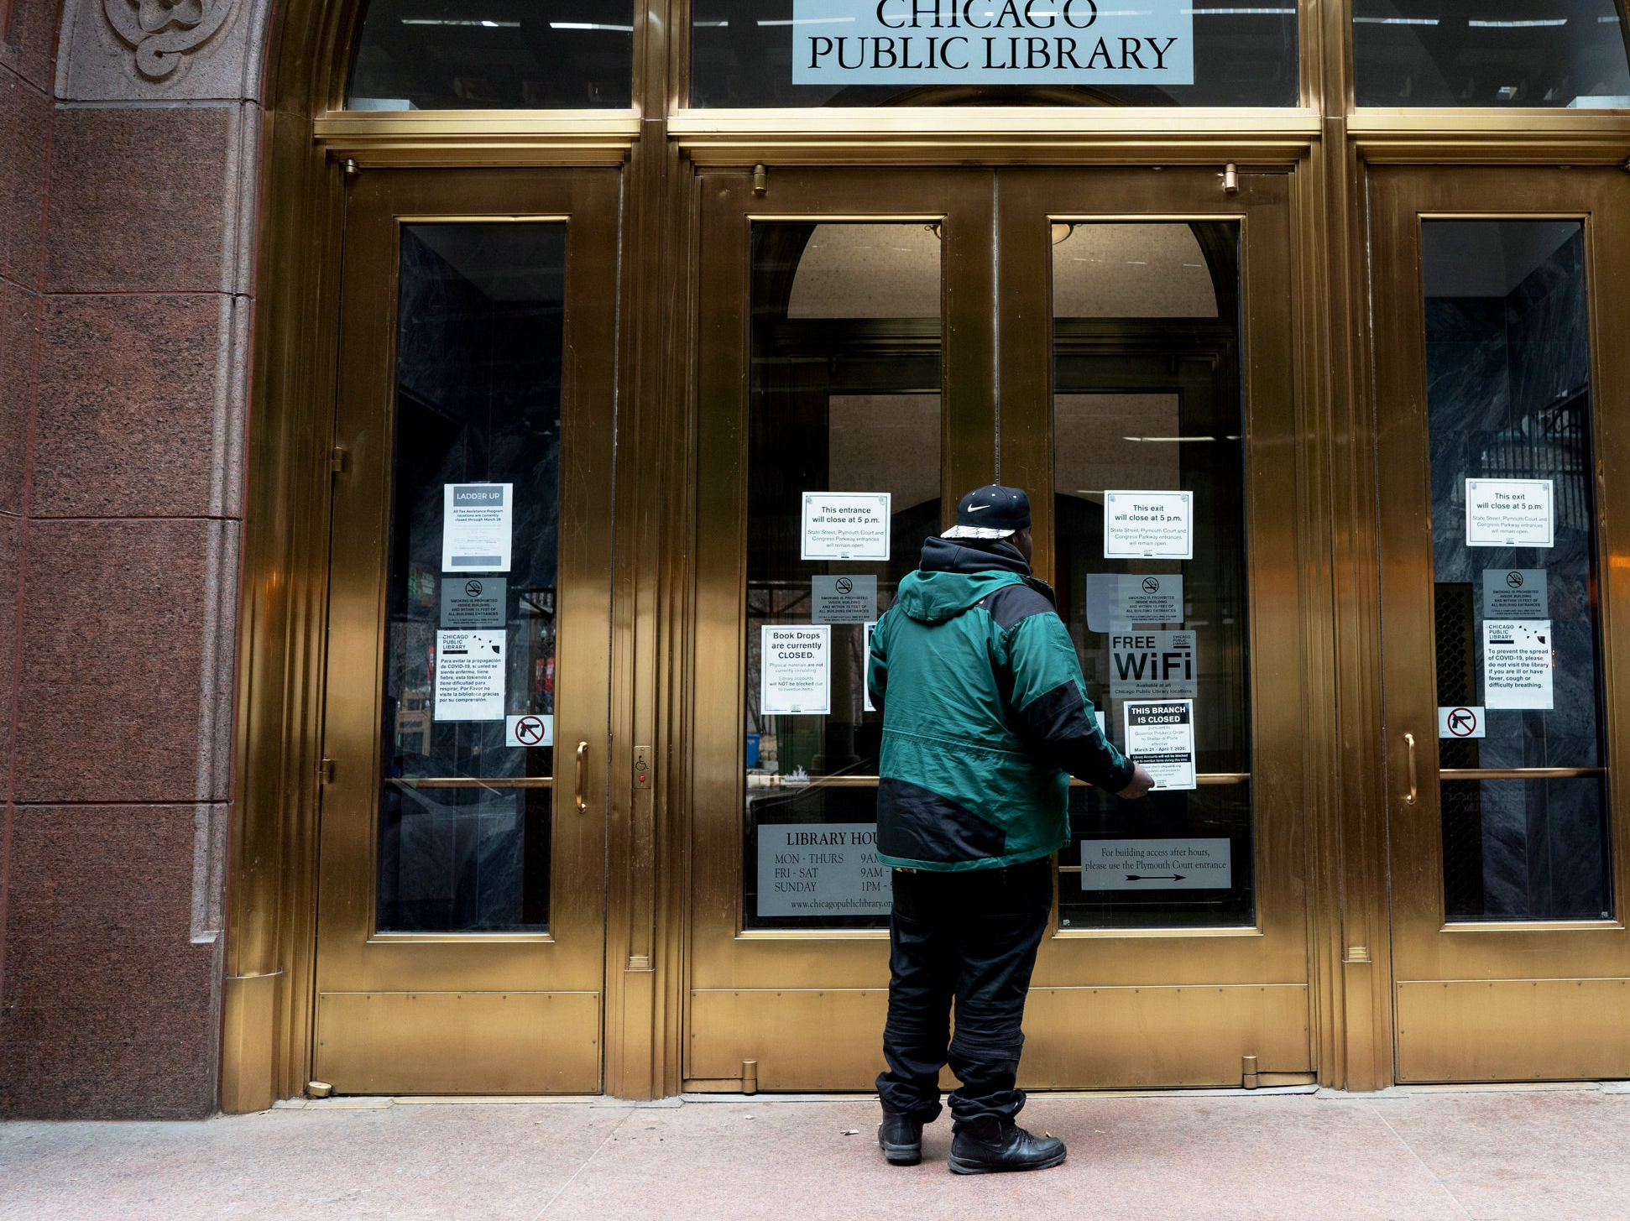
Words of Inspiration
“With school closures and job loss, communities will need libraries more than ever.” Bloomberg CityLab
“Libraries are needed more than ever.” USA Today
“Shuttering public libraries puts a strain on communities” Wired

